Slide 1
WeShare

Slide 2
NO IF
Writing code without IF… possbile
Notes:
The IF is not an evil
The use of IF without thinking about a different and possible solution is the error
Let me show some examples present in YNAP code base in order to understand the reason why wrong use of IF is evil

Slide 3
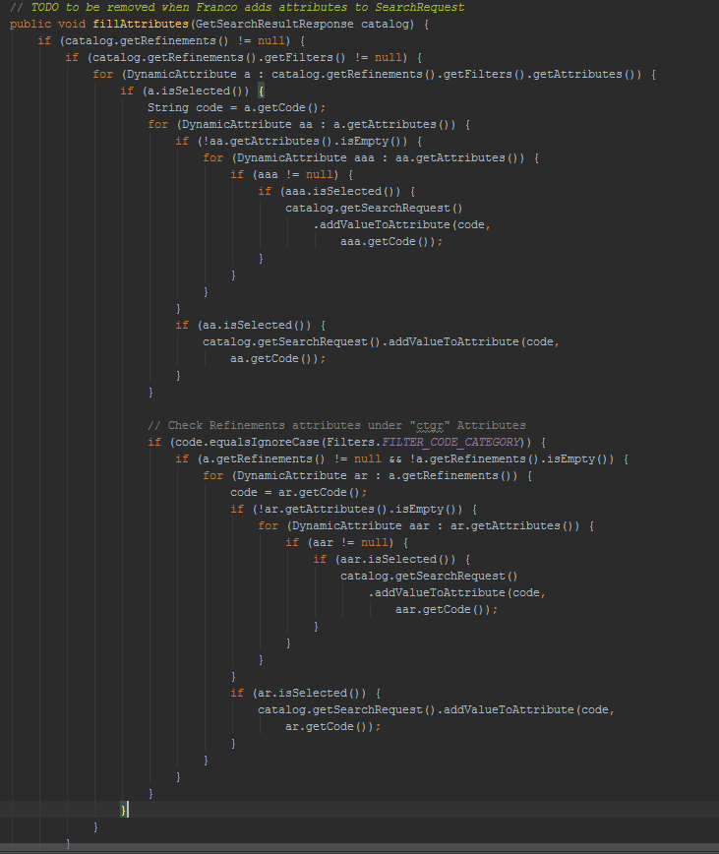
Notes:
YOOX Android app

Slide 4
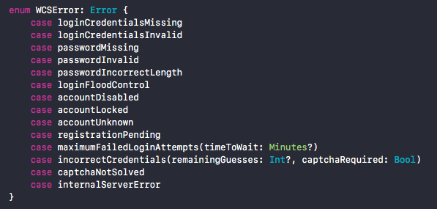
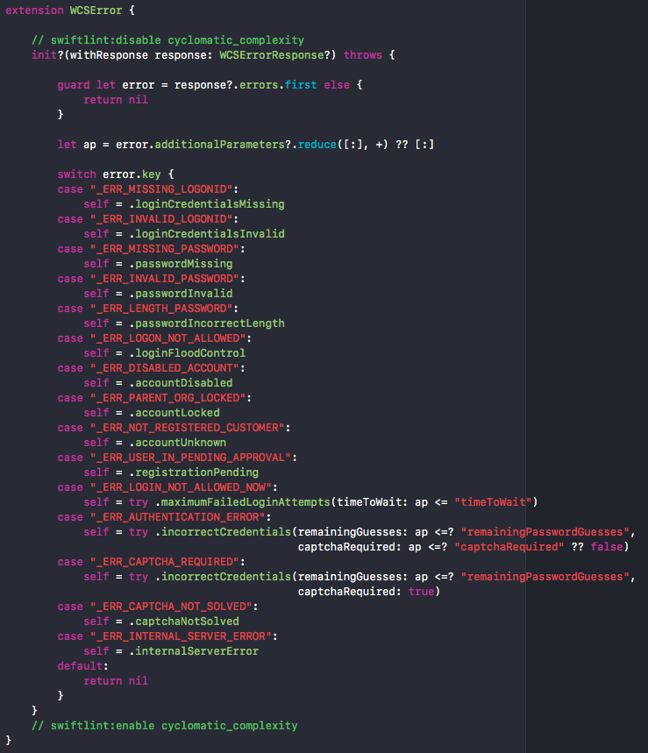
Notes:
YNSDK iOS Mobile framework

Slide 5
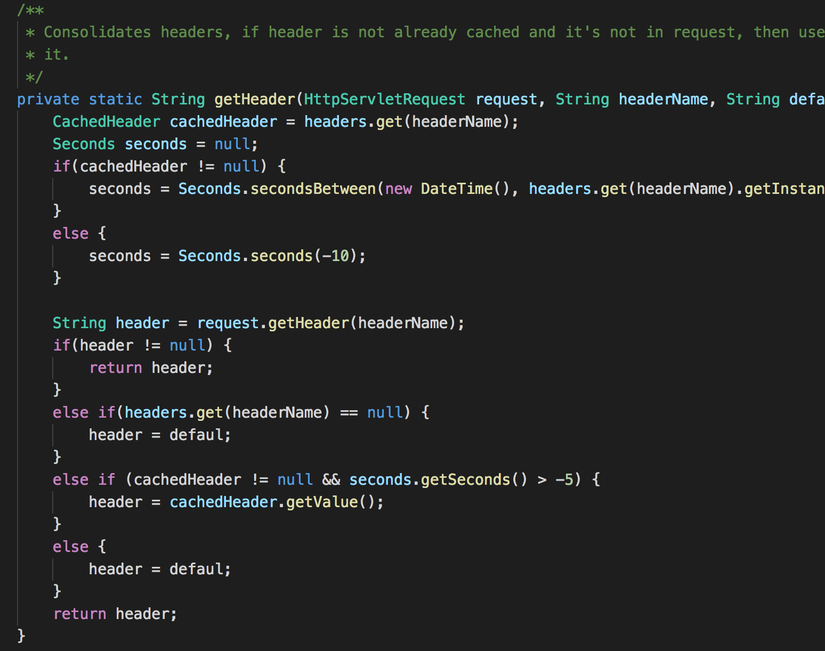
Notes:
WCS platform

Slide 6
What I will speak and coding of …
Analyse four code snippet with IF and SWITCH statements
Try to approach using a different point of view
Understand why the new solution is better then the first one

Slide 7
What I will speak and coding of …
Singleton
Return null
Enums

Slide 8
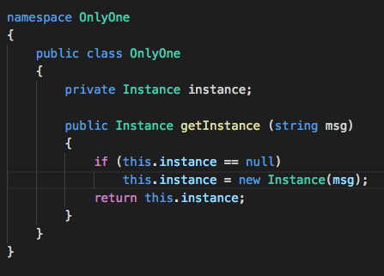
Singleton
Notes:
Every time we call getInstance method we perform an IF statement

Slide 9
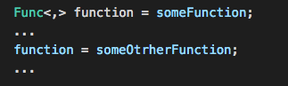
Singleton how to improve your code...
Move into functional world where …
… Functions are first-class citizen …
…so I can write something like this

Slide 10
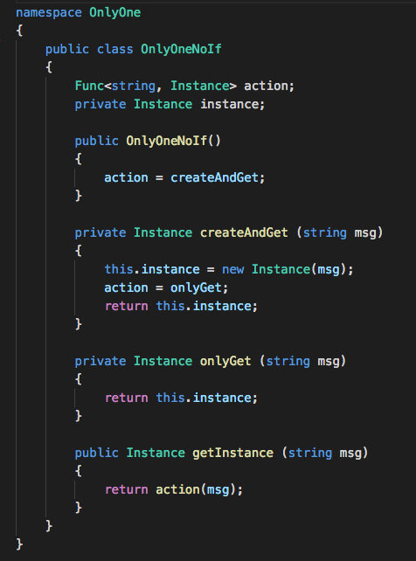
Singleton revisited

Slide 11
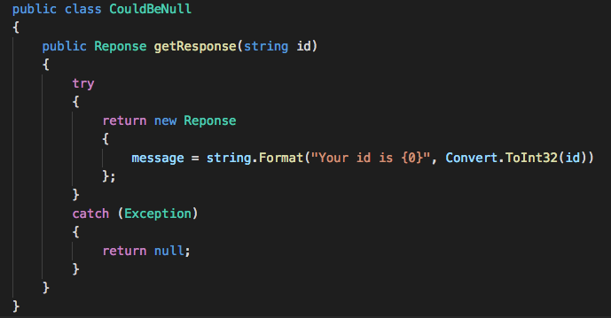
Return null
Notes:
- Sometimes methods return null

Slide 12
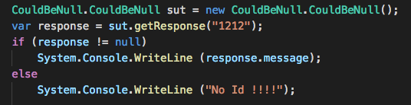
Return null
Client must check the return value …
… to avoid null reference exception

Slide 13
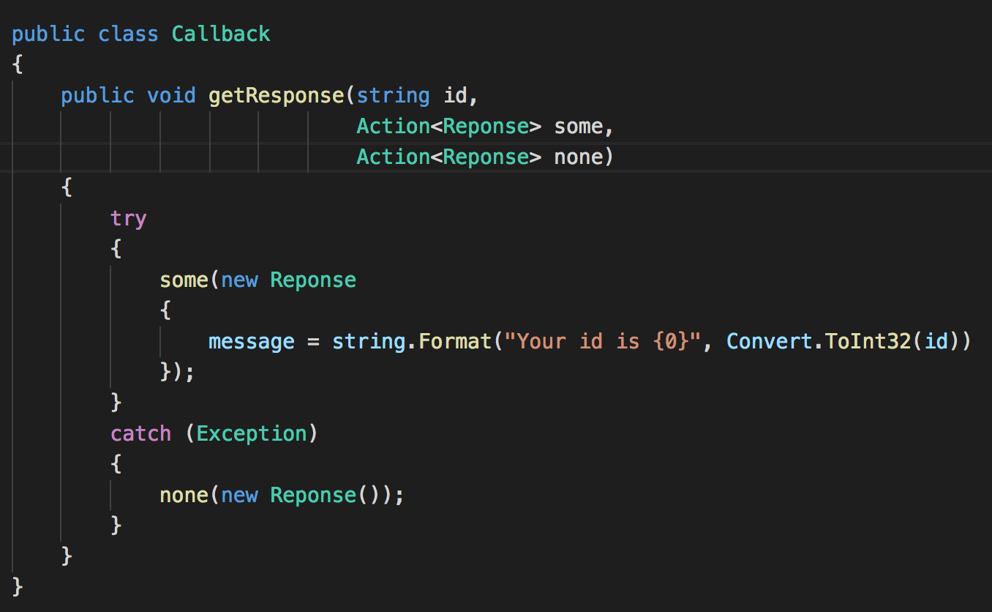
Return null javascript approach using callbacks…
Success callback
No return
Empty
callback

Slide 14
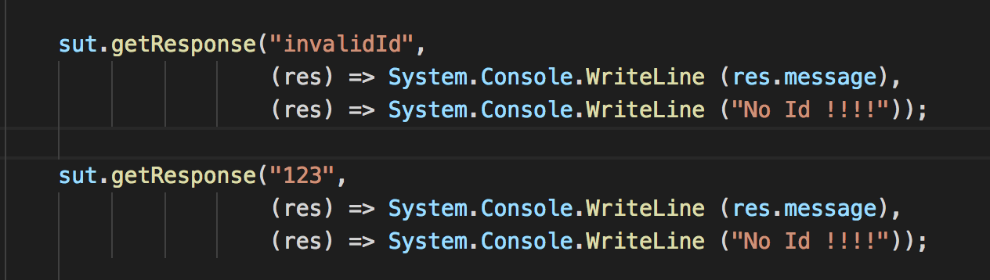
Return null javascript approach from client…
Using callbacks…
… we remove the IF and …
…the code is SAFE

Slide 15
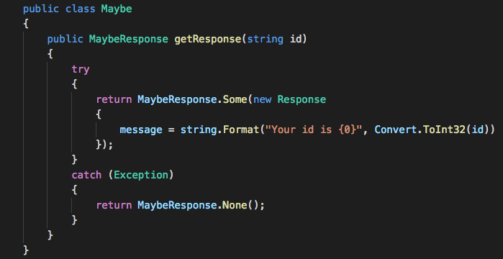
Return null functional approach using maybe monad…
Maybe
Monad

Slide 16
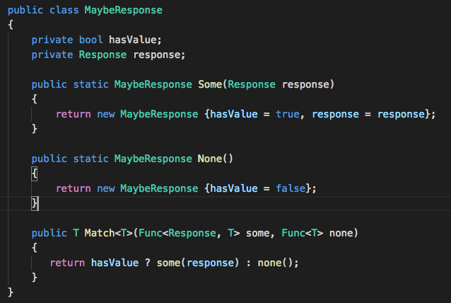
Return null functional approach using maybe monad…

Slide 17
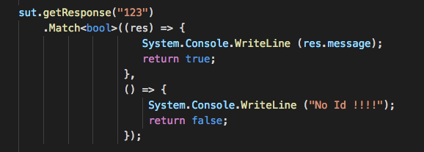
Return null functional approach from client…
Using maybe monad…
… we remove the IF and …
…the code is SAFE

Slide 18
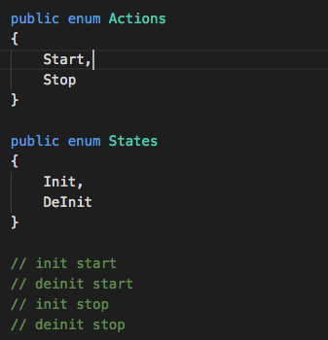
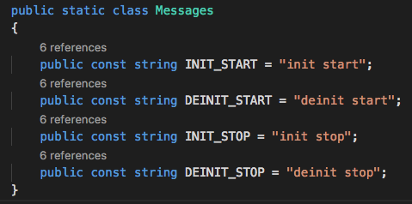
Enums

Slide 19
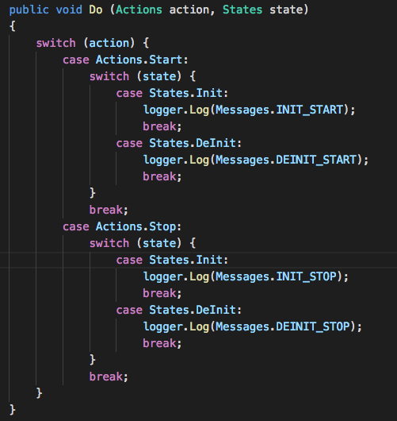
Enums using switch approach…

Slide 20
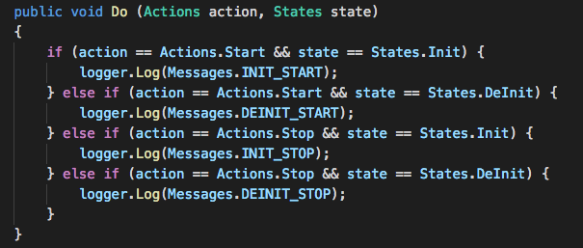
Enums using If approach…

Slide 21
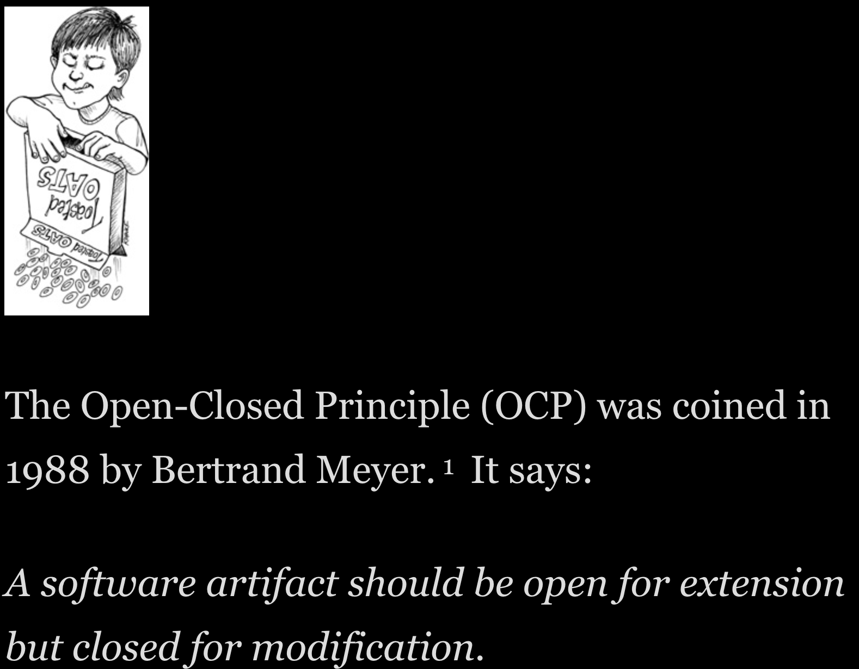
Enums OCP…

Slide 22
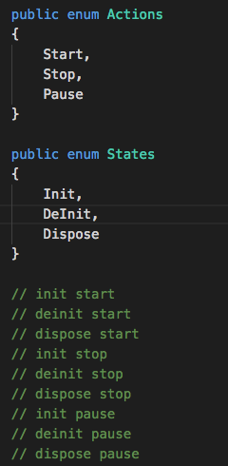
Enums what’s happen if I add some states…

Slide 23
Enums considerations…think different…
For each action and state we have string to show …
… for each key we have value …
... and the key could be a …
… FUNCTION

Slide 24
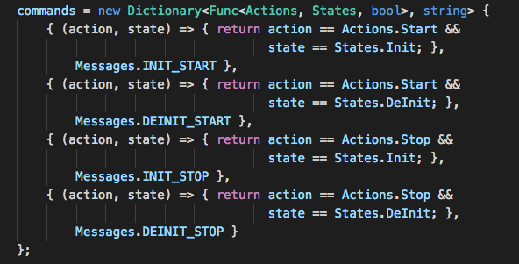
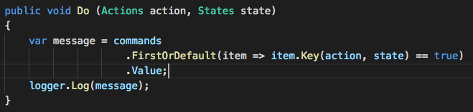
Enums at the end …

Slide 25
No IF
Let programming language functional extension help you
Use a dictionary of objects when possible
Replace conditional with polymorphism
Use dependency injection to resolve the right concrete instance instead of passing flags
Replace conditional with visitor (http://www.refactoring.com/catalog/replaceConditionalWithVisitor.html)

